Slide 1
THẢO CHI

Slide 2
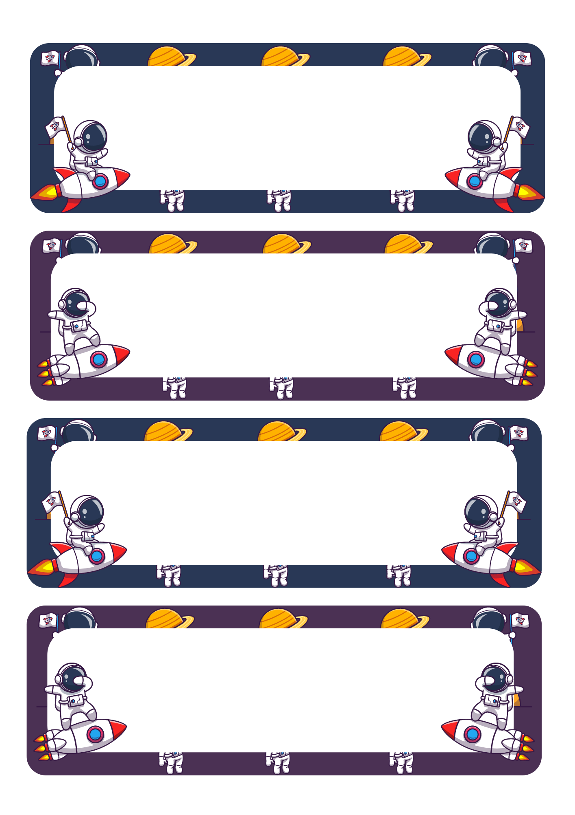
SƠN TÙNG

Slide 3
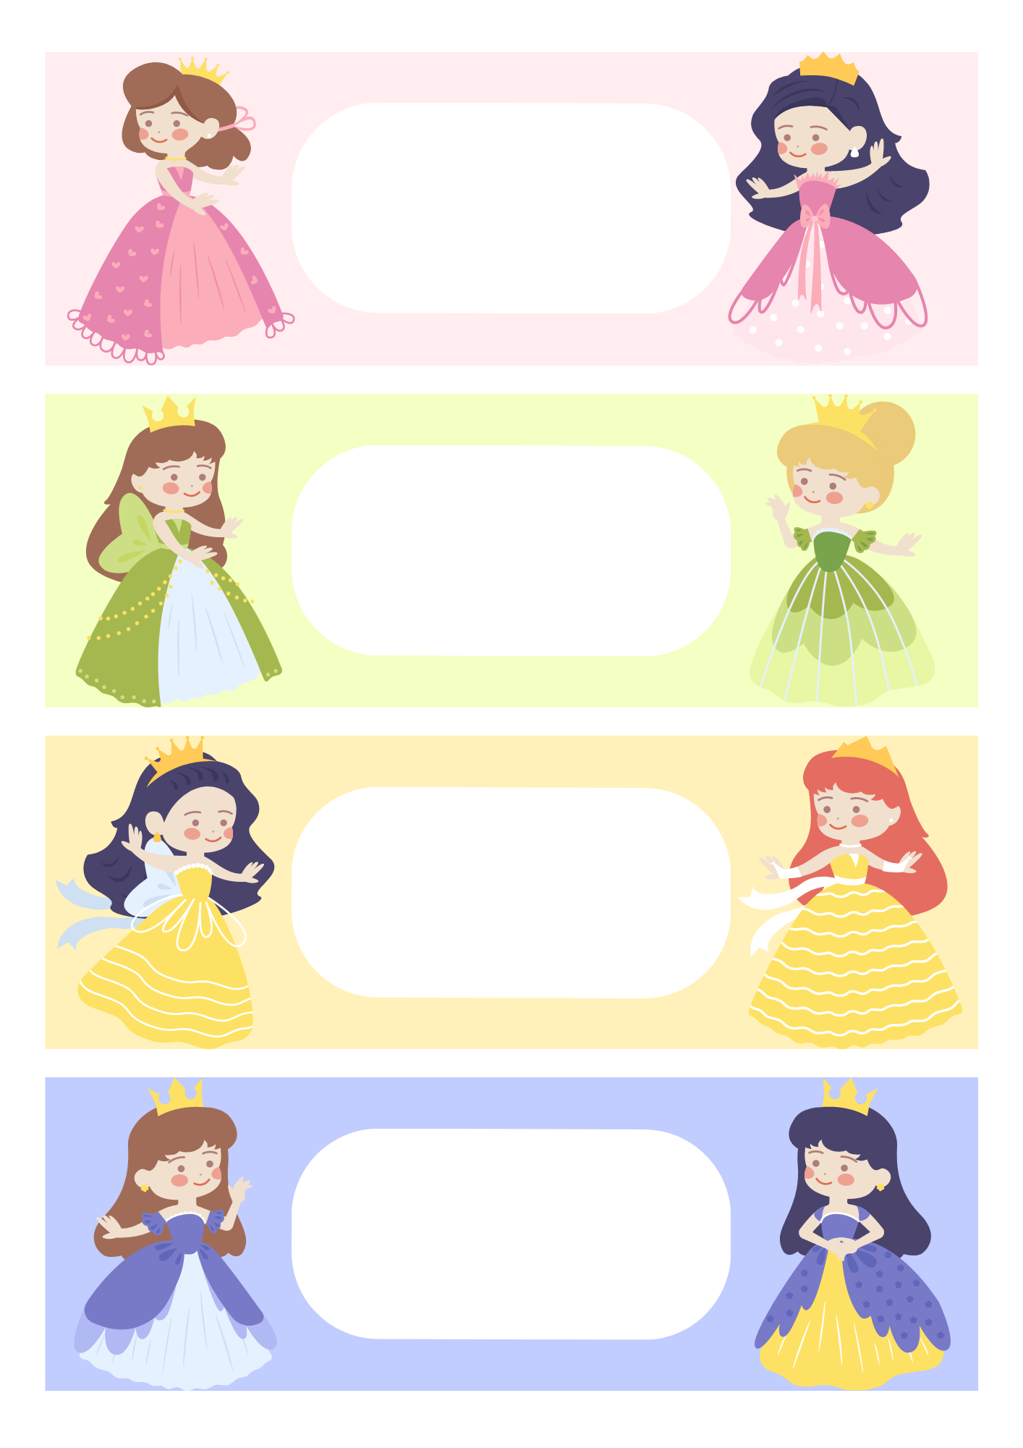
MỸ HẠNH

Slide 4
Con:………………………… Gửi: …………………………
……………………………………………………………………………………………………………………………………………………………....
From: …………………………
……………………………………………………………………………………………………………………………………………………………....
From: …………………………
……………………………………………………………………………………………………………………………………………………………....
From: …………………………
……………………………………………………………………………………………………………………………………………………………....

Slide 5
From: …………………………
……………………………………………………………………………………………………………………………………………………....
From: …………………………
……………………………………………………………………………………………………………………………………………………....
From: …………………………
……………………………………………………………………………………………………………………………………………………....
From: …………………………
……………………………………………………………………………………………………………………………………………………....

